Slide 1






AI/ML in Power BI
Somy Ayazi – Microsoft AI MVP
Atlassian | @SomyAyazi | somy-ayazi​
Notes:
PowerBI​
PowerBI is a business analytics service provided by Microsoft. Using data stored in CDS or other databases, users can build informative reports and dashboards to display important data about sales, customer service, and other business functions. These dashboards and reports can be published on websites, in SharePoint or Teams, and in Apps.​
Power BI, a business intelligence tool for visualizing data with different kinds of charts.
Fundamental change is that data is now coming first​
Modern businesses are starting with systems of observation and intelligence​
Data would drive the starting point​
Bring all your data together into a common data model​
​

Slide 2




Who am I?
Engineering Manager with Atlassian
Co-hosting The Global AI Podcast @GlobalAIPodcast
APAC AI community co-organiser
Atlassian | @SomyAyazi | somy-ayazi​

Slide 3
AI and ML in Power BI
Notes:
PowerBI​
PowerBI is a business analytics service provided by Microsoft. Using data stored in CDS or other databases, users can build informative reports and dashboards to display important data about sales, customer service, and other business functions. These dashboards and reports can be published on websites, in SharePoint or Teams, and in Apps.​
Power BI, a business intelligence tool for visualizing data with different kinds of charts.
Fundamental change is that data is now coming first​
Modern businesses are starting with systems of observation and intelligence​
Data would drive the starting point​
Bring all your data together into a common data model​
​

Slide 4

What is AI?
AI is the creation of software that imitates human behaviours and capabilities and the ability to interact intelligently with the user.​
Key element:​
Machine learning - The way we "teach" a computer model to make prediction and draw conclusions from data.​
Anomaly detection - The capability to automatically detect errors or unusual activity in a system.​
Computer vision - The capability of software to interpret the world visually through cameras, video, and images.​
Natural language processing - The capability for a computer to interpret written or spoken language and respond in kind.​
Conversational AI - The capability of a software "agent" to participate in a conversation
Notes:
A key factor in AI applications is the ability to interact intelligently with the user.​
​
Microsoft Cognitive Services consists of a set of APIs, SDKs and services. The goal is to help developers make their apps more intelligent, engaging, and discoverable.​
Azure Cognitive Services offers intelligent algorithms in vision, speech, language, knowledge, and search​
​
​
Machine learning - This is often the foundation for an AI system, and is the way we "teach" a computer model to make prediction and draw conclusions from data.​
Anomaly detection - The capability to automatically detect errors or unusual activity in a system.​
Computer vision - The capability of software to interpret the world visually through cameras, video, and images.​
Natural language processing - The capability for a computer to interpret written or spoken language, and respond in kind.​
Conversational AI - The capability of a software "agent" to participate in a conversation.

Slide 5
AI in Power BI
Detect Image contents
Detect Language
Sentiment analysis
Key phrase extraction
Supported Services

Slide 6

Detect Image Content
Application: Process large numbers of images and detecting the object on the image using computer vision.
Likely users: E-commers, internet services
Tech: Computer Vision within AI. Models are mostly classification algorithm
Challenges: Label are limited in numbers and lack a structure or taxonomy. Not all language are supported.
Notes:
This function return tags based on more than two thousand recognizable objects, living beings, scenery, and actions. A collection of content tags forms the foundation for an image description displayed as human readable language formatted in complete sentences.
Application cont… : tags given may include: person, cat, hours or more ambiguous “residential” when tags are ambiguous or not common knowledge, the API response provides ‘hints’ to calrify the meaning of the tag. Output is available in English, Spanish, japanease, Portogues and simplified chineses
Use power query

Slide 7

Detect Language
Application: Automatically detecting the language for a piece of text
Likely users: Content handlers (internet services, Academic, History, etc)
Tech: NLP
Challenges: Not available for all languages
Notes:
The language detection function evaluates text input and for each field returns the language name and ISO identifier. This function is useful for data columns that collect arbitrary text, where language is inknown. The function expect data in text format as input
Uses within power query, required premium licens
Mixed language contenct within the same document will only return the language with the largest presence in this case the algorithm will return “unknown”

Slide 8

Semantic Analysis
Application: useful for detecting positive and negative sentiment in social media, customer reviews, and discussion forums, etc.
Likely Users:
Marketing departments
Public Organizations
PR departments
Customer Service representatives
Engine: NLP, Azure cognitive services
Challenge: Required domain knowledge
Notes:
Sentiment analysis and opinion mining are features offered by Azure Cognitive Service for Language, a collection of machine learning and AI algorithms in the cloud for developing intelligent applications that involve written language. These features help you find out what people think of your brand or topic by mining text for clues about positive or negative sentiment, and can associate them with specific aspects of the text.
Application: useful for detecting positive and negative sentiment in social media, customer reviews, and discussion forums, find out out what people think about a certain topc, your brand, product, etc
The Sentiment anlaysus function evaluates text input and returns a sentiment score for each document, ranging it from 0 (negative) to 1 (positive). Common associated words can be drived using technique called “opinion mining” the algorithm also expresses a “confidence level” on both sentence and document level
Both sentiment analysis and opinion mining work with a variety of written languages..
Underlying models & techniques: NLP ( Natural language processing, aspect-based sentiments analysis. This function calls the text analysis PI which belongs to Azure cognitive services offering
Required Permimum Licence.
Challenge: domain knowledge required (e.g. the word “aggressive” in a twitter comment is different on the performance of a football player. Emotions contain a lot of information, but wont be captured by most sentiments analysis techniques, Irony and sarcasm (“I had such a good time waiting 1.5 hours for the waiter to take our order” )
An AI system includes not only the technology, but also the people who will use it, the people who will be affected by it, and the environment in which it is deployed.
Read the transparency note for sentiment analysis to learn about responsible AI use and deployment in your systems. You can also see the following articles for more information:
Transparency note for Sentiment Analysis

Slide 9

Key Phrase Extraction
Application: Save time by automatically deriving the most relevant content from text, an article, social media feeds, survey results an interaction with customer support and many more
Likely Users:
Academic Researchers, Publishing industry
Marketing and PR departments
Intent services, Cyber security, Customer service
Engine: NLP, Azure cognitive services
Challenge: Required domain knowledge
Notes:
The Key phrase extraction function evaluates unstructured text and for each text field return a list of key phrases. The underlying API can process up to thousand text documents per request. Useful for text analysis, especially for a very large document.
Required : premium license.
Also in the NLP class industry lead = GPT3, a 175 billion parameter NLP model.
Challenges: Cfr. Sentiment analysis (based on NLP) , domain and conceptual knowledge (contect), emotions, irony…

Slide 10
Anomaly Detection
Q&A Visual
Smart Narrative Visual
Decomposition Tree
Key Influencer Visualization
Features

Slide 11
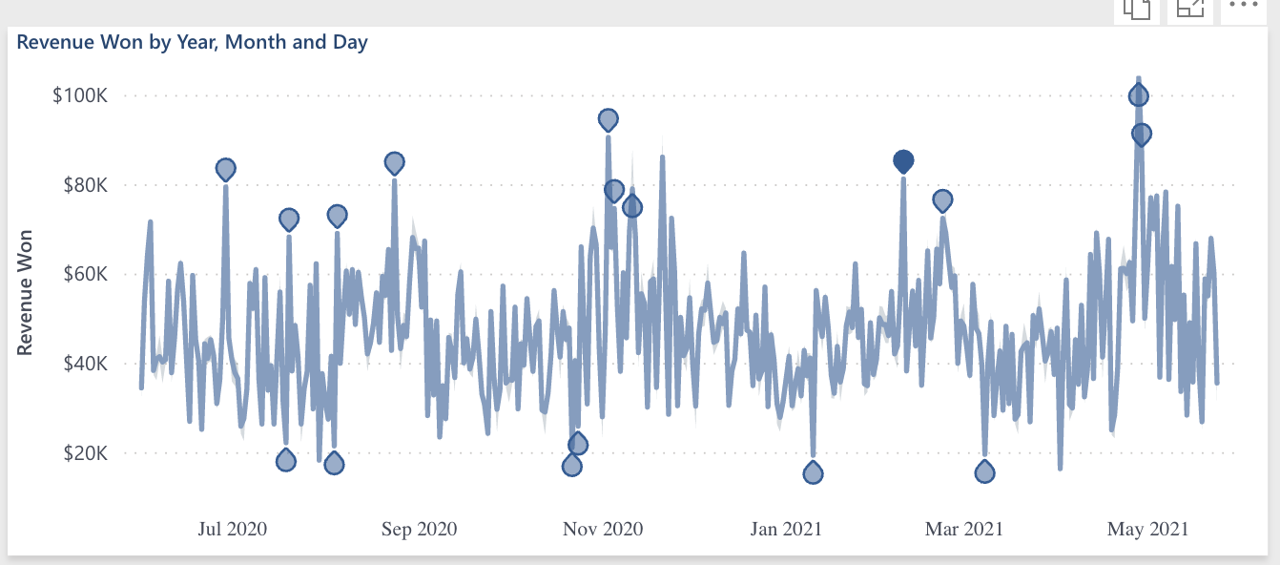
Anomaly Detection
Application: Automatically detect unusual data points, trend changes or other outliers.
Likely users: Banking, security, marketing, retail, etc.
Features
Notes:
Anomaly Detection:
This analytics feature is used to identify unexpected events or rate items in the data. Useful for fraud detection, spotting trend changes, identify cost and revenue outliers and so on. Considered an AI capability as it is build on deep learning framework (SR-CNN)
Application: Automatically detect unusual data points, trend changes or other outliers.
Application cont..: parameters include a sensitivity level (standard = %70), an explanatory variable (optional) and some layout options. When a value goes outside the boundaries set by the confidence/sensitivity level, it’s marked as an anomaly. Afterward click on the outlier to let Power BI return explanatory variable (regression model) as to what factors might explain this outlier. You can help power bi focus on certain factors by dragging them to the anomaly setting pane.
Likely users: Banking, security, marketing, retail, etc.
Standard licencie
Tech: outlier detection model SR (spectral residual) with a CNN
CNN: Convolutional Neural network

Slide 12
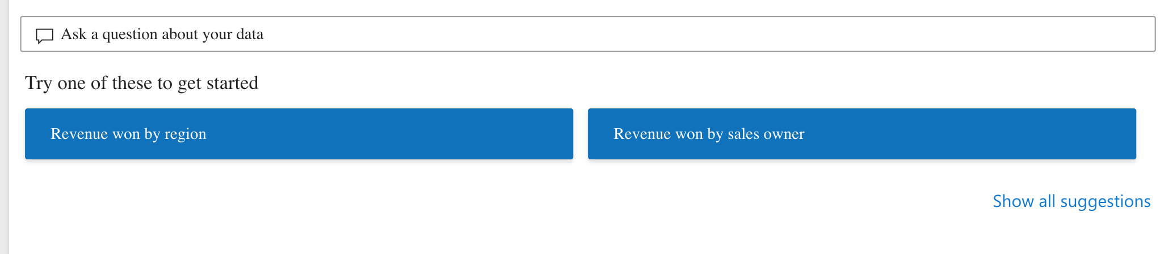
Q&A Visual
It allows users to ask Natural questions and get answers in the form of visuals. Consumers can use it to quickly get answers to their data. Designers can use it to create visual quickly.
Likely users: Sales, finances & HR document, marketing team
Tech: NLP
Features
Notes:
Use cases: asking question regarding the data, either by writing them manually or using a list of featured questions (set by the admin) this allows user to quickly come up with the most relevant insights contained in the data. Report designers can specify the way data should be shown and the Q&Q visual will automatically create this visual for them.
Likely users: Sales, finances & HR document, marketing team.
Requirment: model needs to be set up in the right way. fix incorrect data types,
Challenages: Not all data sou0rces are supported. It has some limitation (geo, multiple statement, storing limitation of posed question, etc)

Slide 13
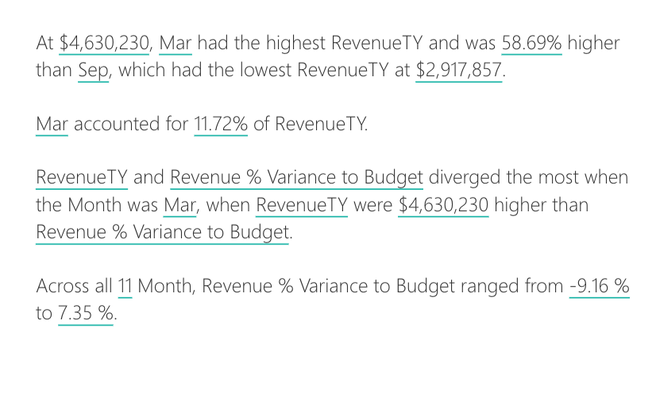
Smart Narrative Visual
Summarize the key takeaways from a visual.
Can be adjusted
Drill down capabilities
Seems to be using NLP and similar to Q&A
Features
Notes:
This visual retrun a textual representation of key insights contained in the underlying data, this allows users to quickly derive the most relevant information contained in the visual. It does so by using NLP.
You can create a template for the summmmary, you have to manually set up the data items that the smart narrative shold return in the summary.
Challanegs: the smart narrative feature doesn’t support a list of functionalities like publishing to web, pinning to a dashboard, using dynamic values and conditional formatting.

Slide 14
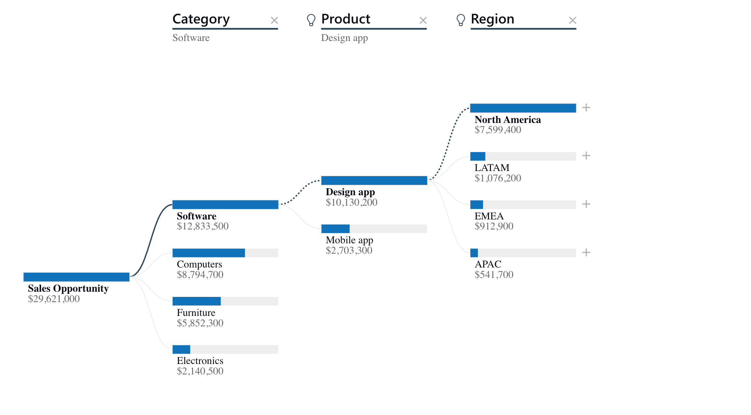
Decomposition Tree
The decomposition tree visual in Power BI lets you visualize data across multiple dimensions,
Automatically aggregate data and enables drilling down into
Valuable tool for ad hoc exploration and conducting root cause analysis.
Features
Notes:
The decomposition tree visual in Power BI lets you visualize data across multiple dimensions, it automatically aggregate data and enables drilling down into your dimensions in any order. It is also an AI visualization, so you can ask It to find the next dimension to drill down into based on certain criteria. This makes it a valuable tool for ad hoc exploration and conducting root cause analysis.

Slide 15
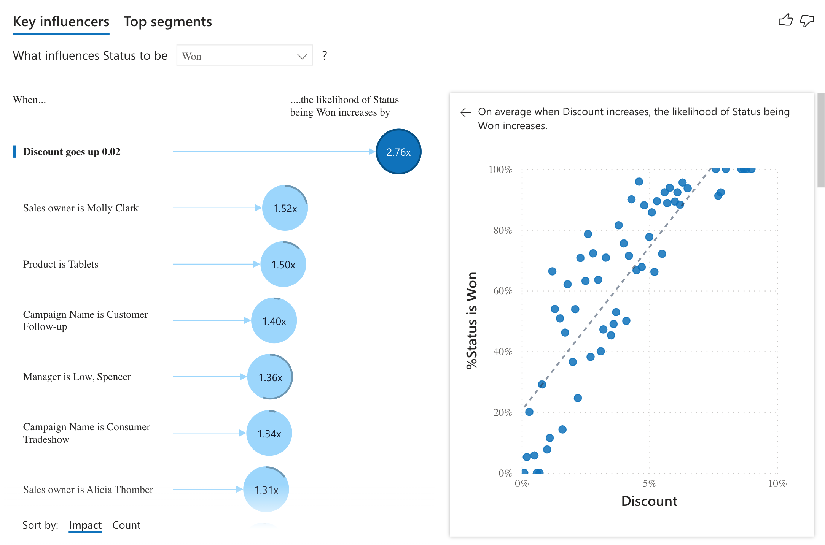
Key Influencer Visualization
It analyses the data based on the selected Key
Ranks the factors that matter and display them as key influencers.
Can also drill down into
Features
Notes:
The key influecners visual helps you understand the factors that drive a metric you’re interested in. it analyses your data, ranks the factors that matter and display them as key influencers.

Slide 16
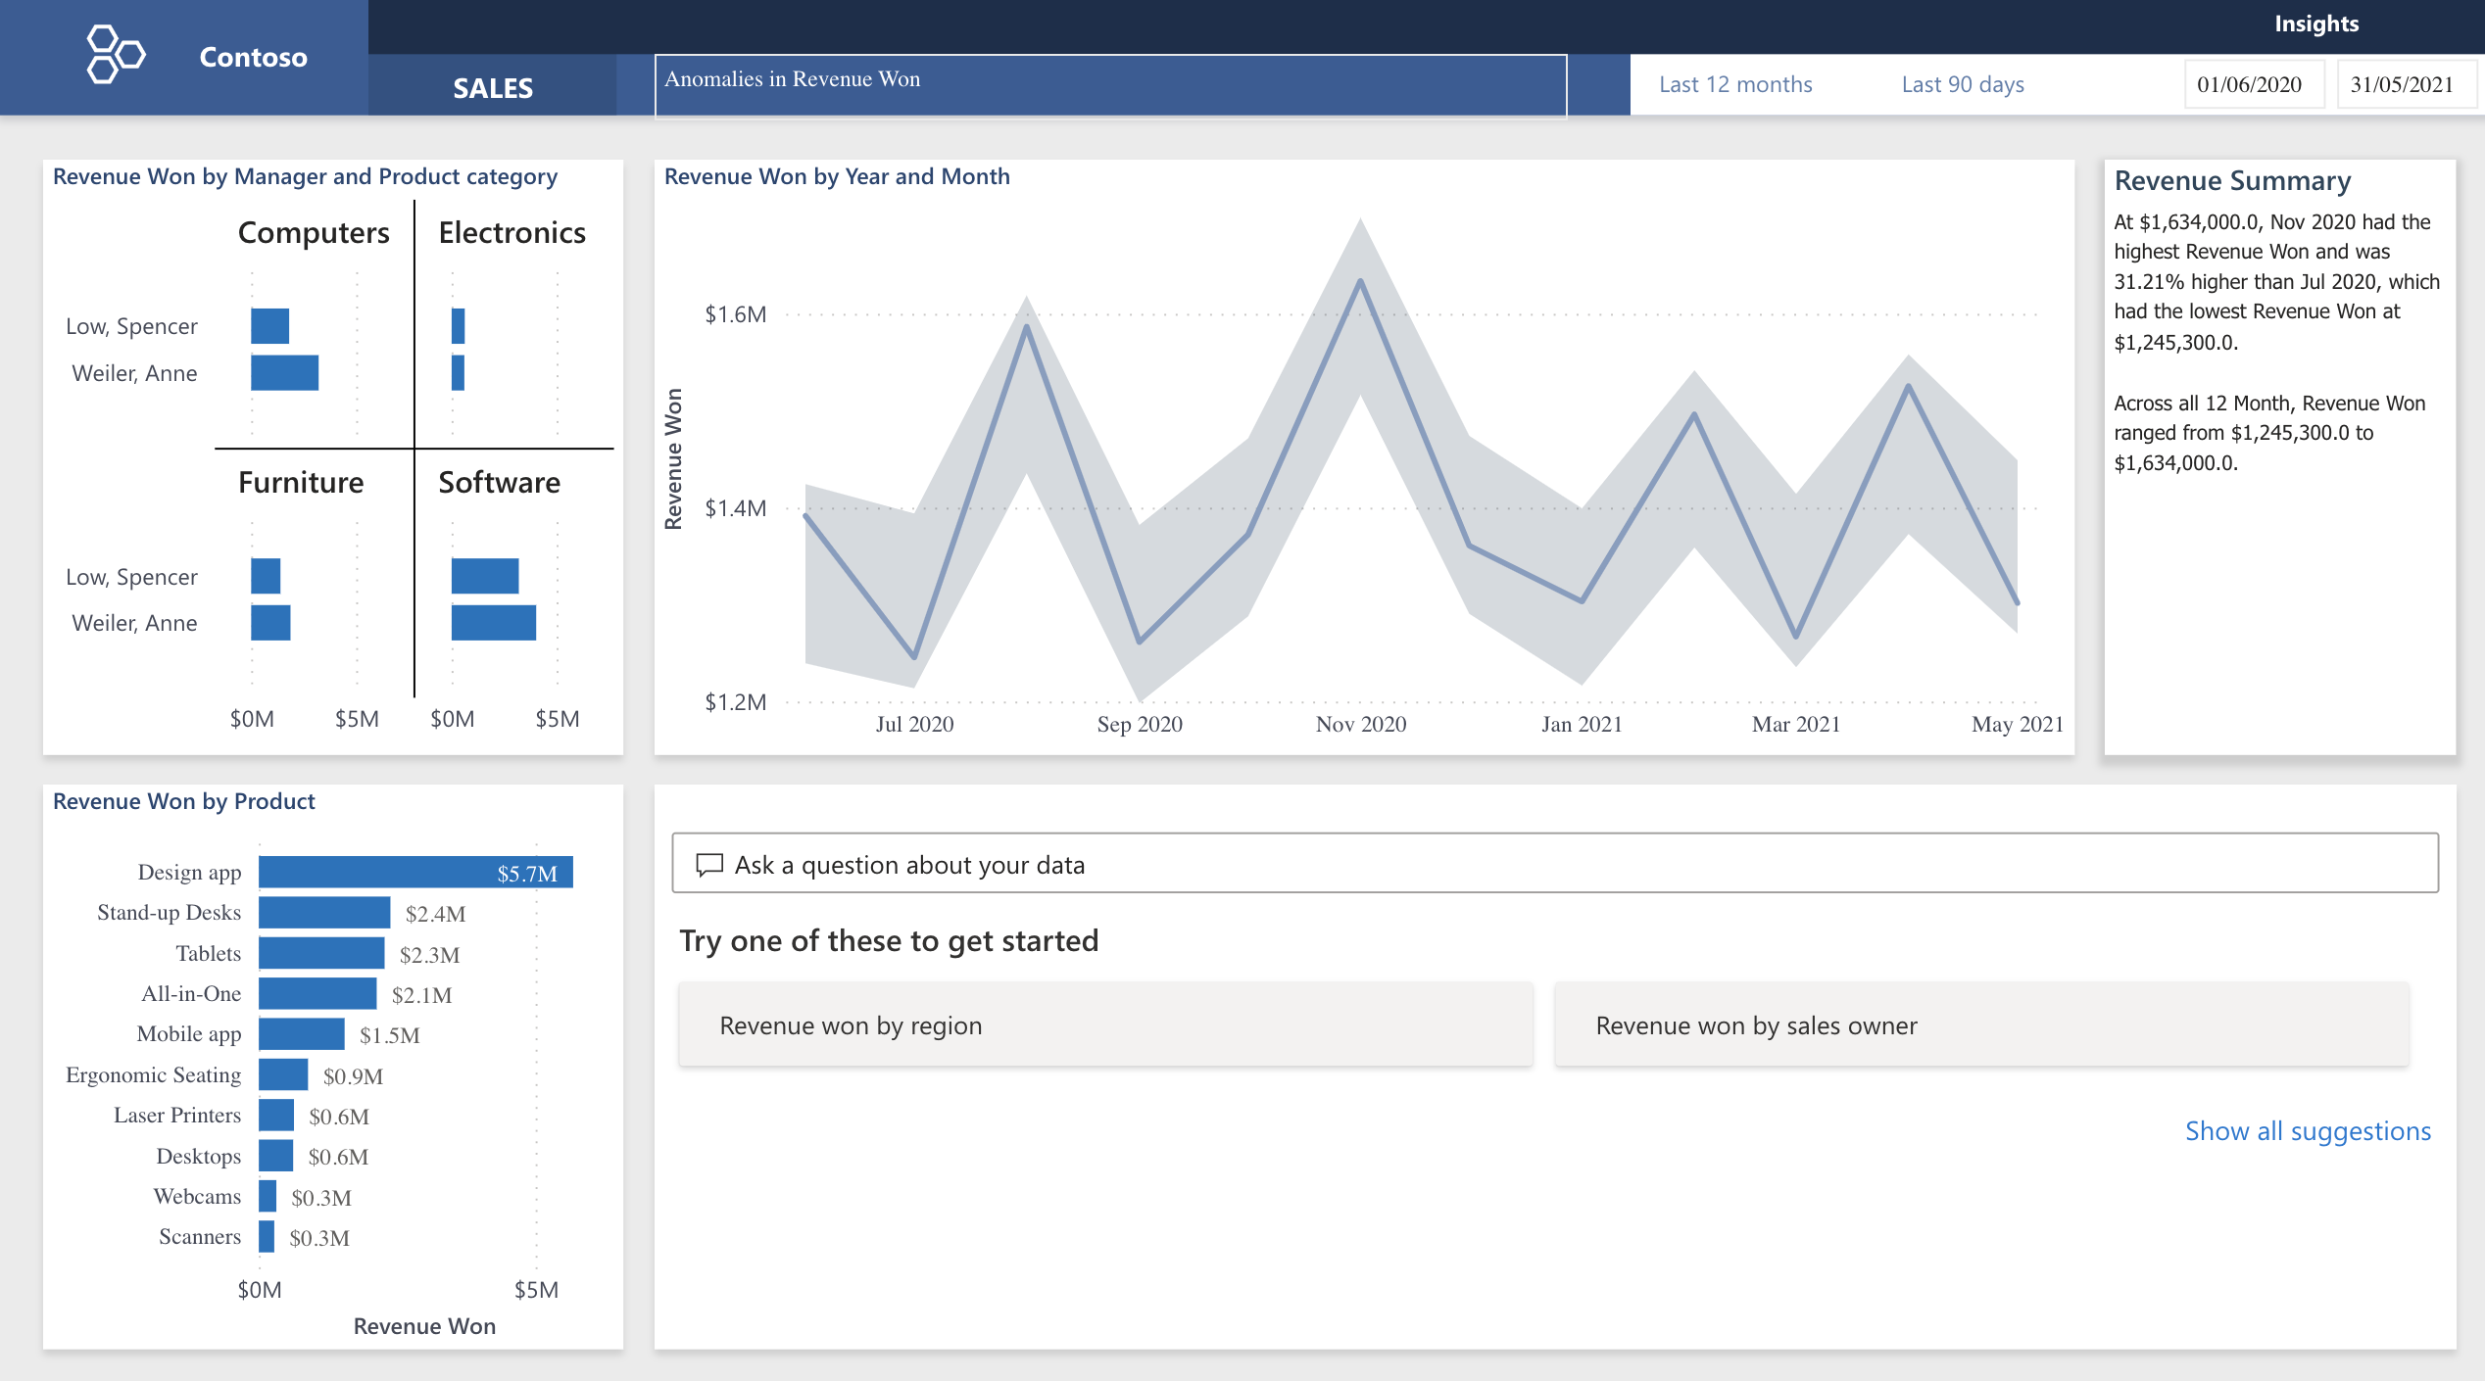

Slide 17
Machine Learning in Power BI

Slide 18
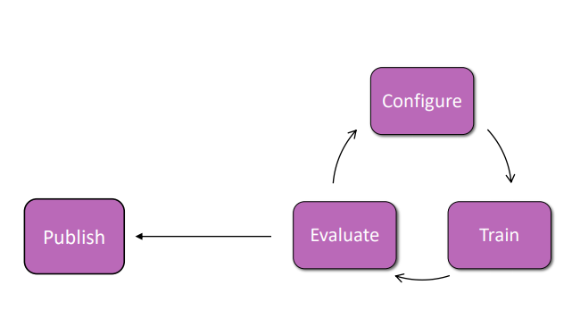
Power BI ML
Choose a model based on the business need
Configure your model
Train Model
Result vary depend on the configuration and data provided to train
Rapidly train and optimize decision making based on trend changes and feedback
Use context to rank options and make the best decisions
Evaluate (performance and quality)
Publish and Score Model
Notes:
The model is the core component of machine learning, and ultimately what we are trying to build. A model might estimate how old a person is from a photo, predict what you might like to see on social media, or decide where a robotic arm should move.
Choose AI template: Select your business problem from a growing set of AI turnkey solutions.
Connect data: Select your business-specific data from Common Data Service. AI Builder does the hard work for you thanks to the Common Data Model.
Tailor your AI model: Filter your data and customize your AI model to best fit your business problem.
Train your AI model: Training is an automatic operation where AI Builder builds your model by teaching it how to solve your business problem (for example, recognize your products on an image) using your business data and customization. Once trained, your AI model can generate insights, such as the result of a prediction or the objects detected on an image.
Use your AI model: Take advantage of the insights provided by your AI model without writing a single line of code. With Power Platform, you can create end-to-end solutions to your business problems, such as creating a flow that automates document processing or an app that predicts whether a supplier will fall out of compliance.
An AI model template is a preset for building a model to solve a particular business scenario, such as classifying customer feedback. Users can tailor a model template to suit their needs with minimal effort. The result of this customization is a business-specific AI model that can be used in Power Apps, Power Automate, and more.
Object detection,
allows you to detect the object based on your company nature. train the model based on the imported picture then, you able to create an application to detect the object
Prediction
a binary prediction such as the customer stays with us or not, do we get the new offer or not, should we give the loan or not….all two situation prediction can be categorized in this group.
From processor
the form Processor is a new service in Cognitive Services (see from here) that able to be trained to learn a form and extract each part ( cell) of the form content. This makes life easy to create an application that able to take pictures of the forms and extract its different elements
Text Classification
This service helps you to tag and find the main elements of the text you have from your customer or in company documents. “Text classification is one of the fundamental natural language processing (NLP) problems. It allows tagging of text entries with tags or labels that can be used for sentiment analysis, spam detection, and routing customer requests, just to name a few examples.”
The sentiment analysis prebuilt model can be used to detect positive or negative sentiment in social media, customer reviews or any text data you want to analyze. This model evaluates text input and return scores and labels at a sentence and document level. The scores and labels are positive, negative, and neutral. At the document level, the mixed sentiment label (not the score) also can be returned. The sentiment of the document is determined by aggregating the scores of the sentences.

Slide 19
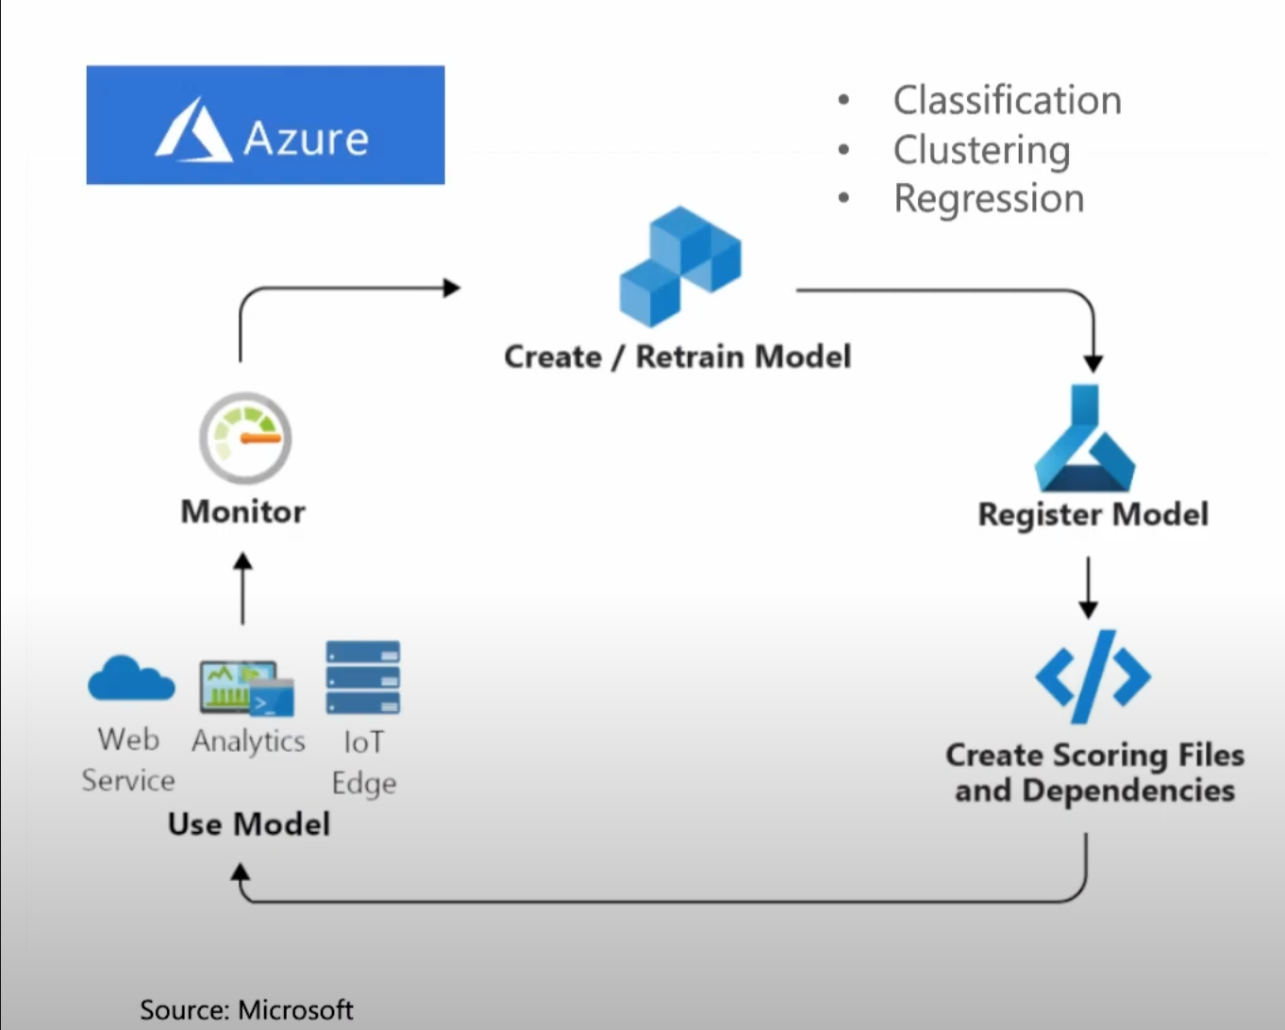

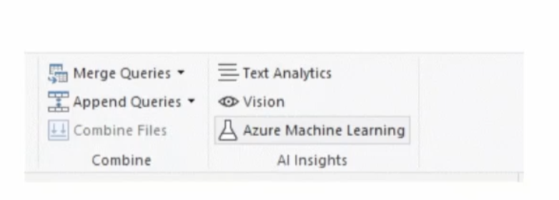
Notes:
Regression: Predicting a continuous quantity
Classification: prediting a category
Doesnot include unsupervised models and forecasting
Lets see if we can demo it in the power BI
I am going to use Automated Machine Learning to create and apply a binary prediction model in Power BI. The tutorial includes guidance for creating a Power BI dataflow, and using the entities defined in the dataflow to train and validate a machine learning model directly in Power BI. We then use that model for scoring new data to generate predictions.

Slide 20
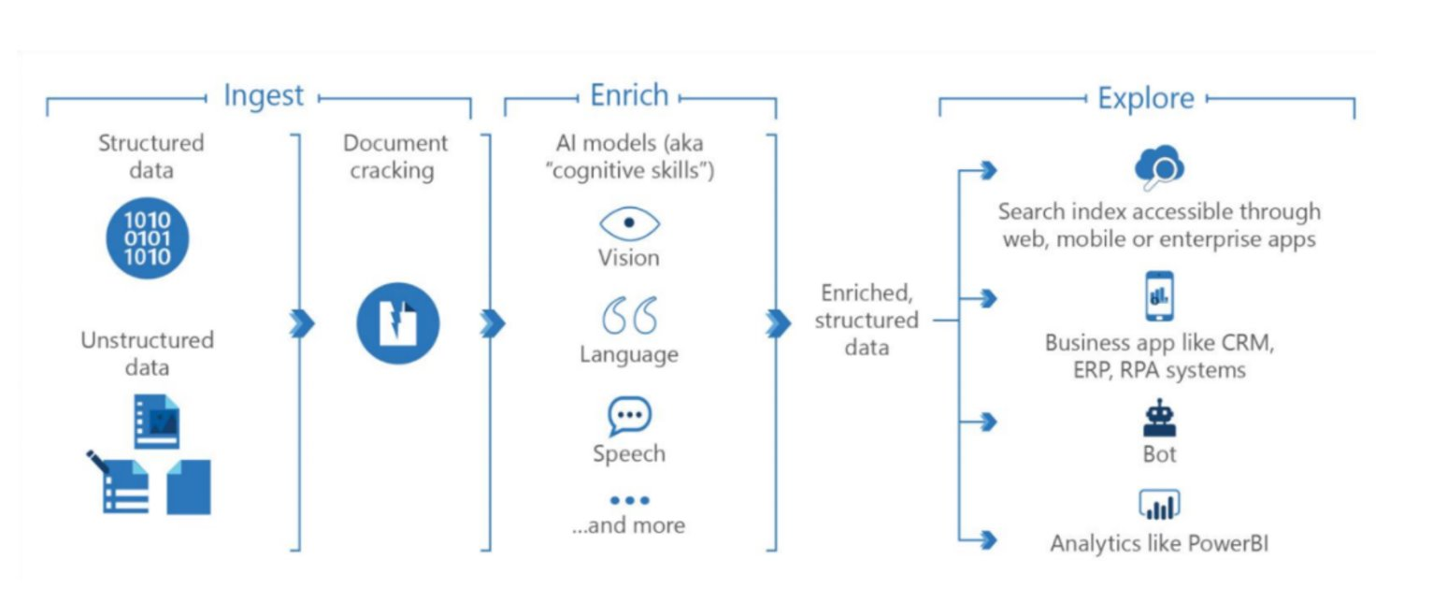
Knowledge Mining
Knowledge Mining orchestration steps (Source Microsoft)​
https://azure.microsoft.com/en-au/solutions/knowledge-mining/#solution-architectures​
Notes:
Language ​
People​
Organization​
Location​
Images​
Key Phrase

Slide 21
Explore AI more
AI School: https://www.microsoft.com/en-us/ai/ai-school​
AI Lab: https://www.microsoft.com/en-us/ai/ai-lab​
https://docs.microsoft.com/en-us/training/modules/introduction-to-machine-learning/
https://docs.microsoft.com/en-au/power-bi/connect-data/service-tutorial-build-machine-learning-model
Transparency note for Semantic Analysis https://docs.microsoft.com/en-us/legal/cognitive-services/language-service/transparency-note-sentiment-analysis

Slide 22
“AI is here to empower People to be able do more with Technology”
Thank you!
Atlassian | @SomyAyazi | somy-ayazi​

